Slide 1
COMP4033 Computer Graphics Lecture 2: Review of Basic Math
Spring 2025
Prof. Amy Zhang

Slide 2
To Do
Complete Assign 0
Get help if issues with compiling, programming
About first few lectures
Somewhat technical: core math ideas in graphics
Assign1 is simple (only few lines of code): Let you see how to use some ideas discussed in lecture, create images
Notes:
First, you should complete assign0. And being able to compile assign0 will ensure you have your complier set up, OpenGL.
The first few lectures in this course talk about some of the core mathematical and technical ideas in computer graphics. They're some of the most beautiful ideas in computer graphics. Assign 1 has only a few lines of code, so it's relatively simple compared to assign 2 and 3. But I should mention that you should still start early on assign 1, because it is the first assignment, and moreover, even though it only has a few lines of code, there is quite some thinking to be done.
The idea of assignment 1 is to use some of the ideas in the first few lectures to generate your first images.

Slide 3

Motivation and Outline
Many graphics concepts need basic math like linear algebra
Vectors (dot products, cross products, …)
Matrices (matrix-matrix, matrix-vector mult., …)
E.g: a point is a vector, and an operation like translating or rotating points on object can be matrix-vector multiply
Should be refresher on very basic material for most of you
Only basic math required
Notes:
We start with the overall motivation of this section.
Many computer graphics concepts need basic mathematics like linear algebra. We are interested in vectors, dot products, cross products. We are also interested in matrices, matrix-vector and matrix-matrix multiplication. How does this come up? Assume for example that you have a point that you want to translate to a different region. This comes up all the time, you have a character, you want to move it somewhere else in the scene. You can regard the point as a vector and we'll see how an operation like translation, rotation can be written as a matrix-vector multiplication.
The contents of this lecture on vectors and matrices should be very basic for most of you. It does not go beyond what you would learn in a basic high school mathematical education.

Slide 4
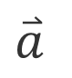
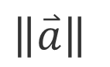
Vectors
=
$$\overset{⃑}{a}$$
$$\left\|\overset{⃑}{a}\right\|$$
Usually written as or in bold. Magnitude written as
Length and direction. Absolute position not important
Use to store offsets, displacements, locations
Notes:
We'll start by talking about vectors. Vectors are usually written with the vector symbol, so this is the common vector symbol, an arrow on top. Or, if you look at other references, they are often written in bold. The magnitude is written in the standard way by putting a norm symbol around the vector. Vectors have a length and they have a direction.
The absolute position of a vector is not important. And so these 2 vectors are actually the same. So this vector moves to right and I just relocate the vector here, but they are actually the same vector. Vectors are used to store offsets, displacements and locations. But strictly speaking, there is a minor technical difference, that a position is not a vector and in fact you cannot add positions as vectors, because to have a positions such as 2 units on the X axis, we implicitly require an origin. Whereas, a vector is supposed to be independent of the origin, can be relocated. Nevertheless, it is very convenient to also represent positions as vectors, and to multiply them as matrices to do various transformations.

Slide 5
Vector Addition
a+b = b+a
b
a
Geometrically: Parallelogram rule
In cartesian coordinates (next), simply add coords
Notes:
The first vector operation we are going to consider is vector addition. And so you have 2 vectors a and b, and you want to find what is the vector, a + b. This can be done geometrically with what is known as, the parallelogram ˌpærəˈleləɡræm rule. So, here you have the vector a. I take the vector b and I relocate b, so that the tail of vector b is aligned with the head of vector a.
And I complete the parallelogram and the diagonal of the parallelogram is the addition. If you don't want to think in terms of parallelograms, just think about it in terms of a triangle. So, I am considering the vector a + b from the tail of a to the head of b.
Vector addition is commutative, so a + b is equal to b + a and if you are not very much into parallelograms, then we can consider it as simply adding coordinates in Cartesian components.

Slide 6
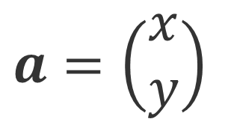
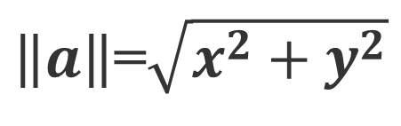
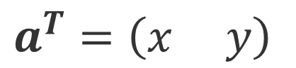
Cartesian Coordinates
Y
X and Y can be any (usually orthogonal unit) vectors
a = 4 X + 3 Y
X
$$a=\left(\begin{matrix}x \\ y\end{matrix}\right)$$
$$a^{T}=\left(x y\right)$$
$\left\|a\right\|$=$\sqrt{x^{2}+y^{2}}$
Notes:
let's consider Cartesian coordinates, your familiar X and Y coordinates. I've shown the X axis and the Y axis. The vector I've shown here can be moved to the origin of the Cartesian coordinate system.
And you can see in this case, it has 4 units along the X axis and 3 units along the Y axis. So the vector can be written as 4 times the unit X vector plus 3 times unit Y vector. X and Y, in this case are the coordinates of the axis. But, in general they can be any orthogonal unit vector. So, I write the vector A as the components X and Y.
It's also interesting, sometimes, to write the transpose of A. So I'm writing a vector as a column vector. Its transpose is a row vector, x and y. And the norm of A is going to be square root of x^2 + y^2. Which, in this case, is the square root of 4^2 + 3^2 which will be equal to 5. That's just the Pythagorean /pɪθəˈgɔriən/ relationship. It's important to note that x and y can be any unit vectors.

Slide 7
Vector Multiplication
Dot product
Cross product
Orthonormal bases and coordinate frames
Note: Some books talk about right and left-handed coordinate systems. We always use right-handed
Notes:
Vectors can also be multiplied and in fact there are 2 multiplications of vector, the dot or the scalar product and the cross or the vector product. Note that in this lecture we will use right-handed coordinates, which is a standard coordinate system found in most mathematics textbooks.

Slide 8
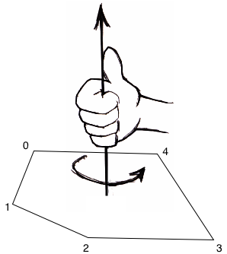
Right hand role
Four fingers extend in the order of the vertexes, in the example, it’s 1->2->3->4.
Thumb towards the front of the surface, in the example, it’s upward.
The surface back: downward
z
y
x
Notes:
What do right-handed coordinates mean? If you take your right hand and your X axis is pointed here, your Y axis is pointed here. If you take your hand and you curl them around the X and Y axes, the thumb on the right hand will point towards the positive Z axis. With left-handed coordinates it would of course be the opposite and so we assume right-handed coordinate system.

Slide 9
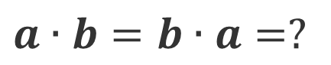
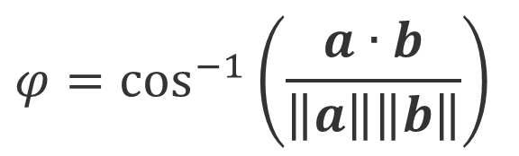
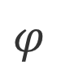
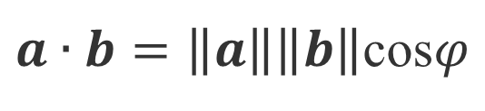
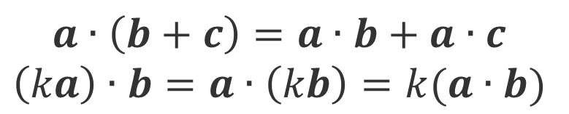
Dot (scalar) product
b
$$φ$$
a
$$a∙b=b∙a=?$$
$a∙b=\left\|a\right\|\left\|b\right\|$cos$φ$
$$a∙\left(b+c\right)=a∙b+a∙c$$
$$\left(ka\right)∙b=a∙\left(kb\right)=k(a∙b)$$
$$φ=\cos^{−1}\left(\frac{a∙b}{\left\|a\right\|\left\|b\right\|}\right)$$
Notes:
First, let's consider the dot or the scalar product and that is written as a dot b. It's commutative. It's also equal to b dot a. We want to consider the norm of a, so of course the product involves the product of the two vectors a and b, so we do want to consider this norm of a.
And now of course it is symmetric, so we will also want to consider the norm of vector b. How does it depend on the angle between a and b? That's the crucial question. And its intended to be the product of their magnitudes when the vectors are aligned. But, when they are not aligned, we will have to multiply it, by the cosine of the angle between them.
As we see here, a dot b is the norm of a times norm of b times the cosine of the angle between them. From that equation, you can calculate the angle between two vectors, as the inverse cosine of a dot b divided by each of their individual magnitudes.
This is in fact is one of the most common uses of the dot product, because the dot product can be calculated very efficiently in Cartesian components, but the angle between two vectors not that easily. So, what you do is, you take the dot product, and then by taking the inverse cosine, you get the angle between the 2 vectors.
The dot or scalar products has the associativity and the multiplication properties. So a dot (b + c) is equal to a dot b + a dot c.
And if you multiply a scalar through any of the vectors k dot b or a dot kb that just multiplies the dot product by a scalar.

Slide 10
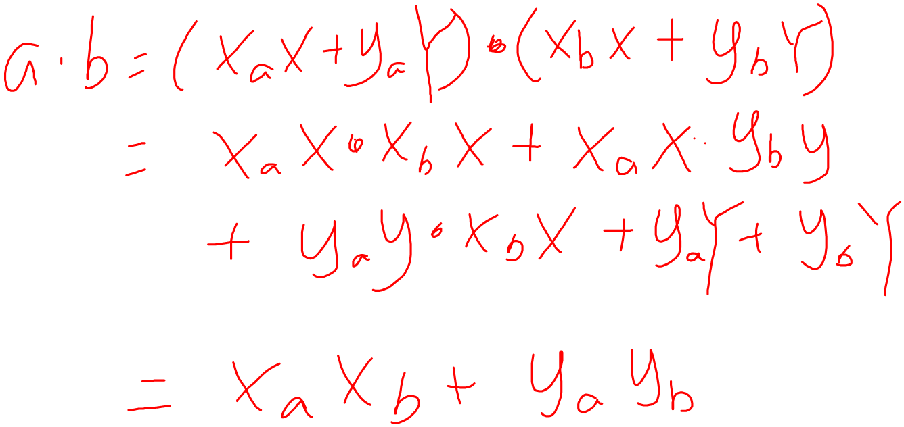
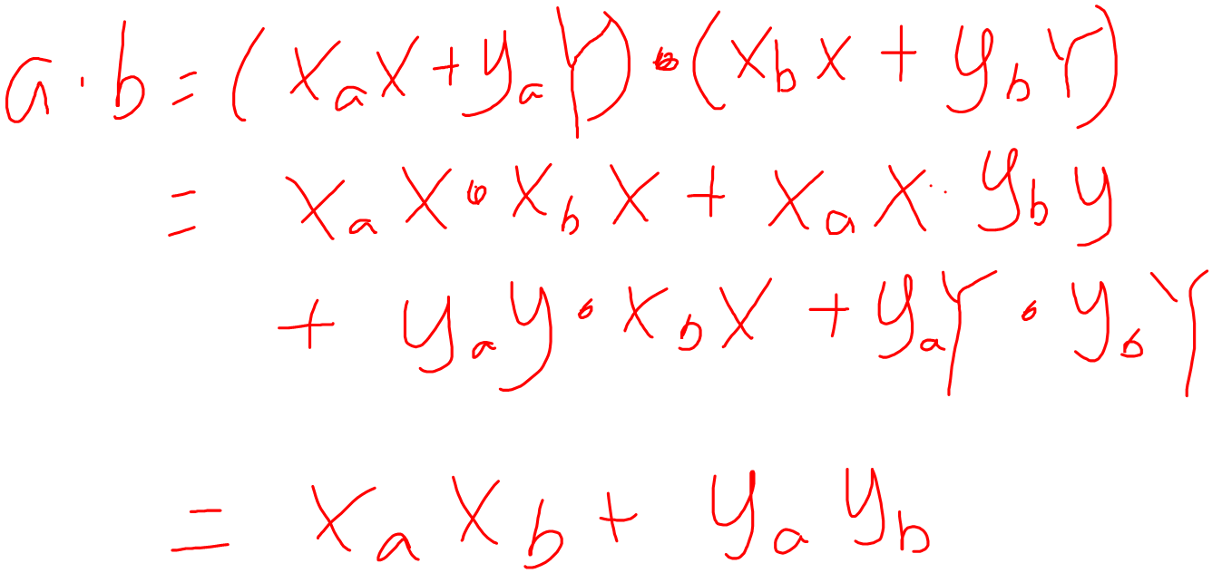

Slide 11
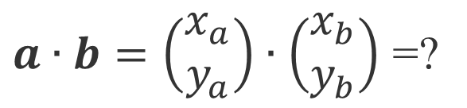
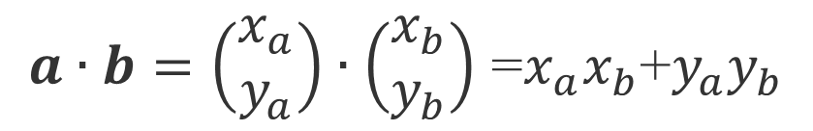
Dot product in Cartesian components
$a∙b=\left(\begin{matrix}x_{a} \\ y_{a}\end{matrix}\right)∙\left(\begin{matrix}x_{b} \\ y_{b}\end{matrix}\right)$ =?
$a∙b=\left(\begin{matrix}x_{a} \\ y_{a}\end{matrix}\right)∙\left(\begin{matrix}x_{b} \\ y_{b}\end{matrix}\right)$ =$x_{a}x_{b}$+$y_{a}y_{b}$
Notes:
The question now is, what is the dot product in Cartesian components? And this is something we can derive. So I write the dot product as x_a. And now, this is in a particular direction. So it's in the direction of the X vector. And the next coordinate is y_a, which is in the direction of the Y vector.
Okay, so I am going to take dot product of this with the same thing for b and b will be written as x_b times the X vector plus y_b times the Y vector.
If we now consider and expand these things out, we have the following. So we have x_a * X times x_b * X and I can write that. I can also include the y_a * y_b term and that will multiply Y dot Y. Finally, I can include the X dot Y terms. X dot Y terms and so I can write plus X dot Y. And that will be multiplied by x_a * y_b + x_b * y_a. But what you can immediately realize is that, because the cosine of the angle between X and Y is 0, the angles X and Y are away by 90 degrees. Cosine of 90 degrees is 0. So this quantity is actually equal to 0. And therefore, we only care about this term here.
And, of course, I have the equation on the next slide. Where a dot b is equal to the dot product of [x_a, y_a] and [x_b, y_b]. And this is simply equal to x_a * x_b plus y_a * y_b.

Slide 12
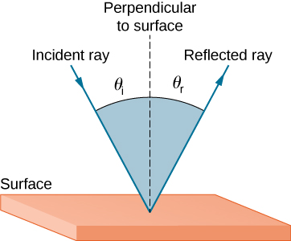
Dot product: some applications in CG
Find angle between two vectors (e.g. cosine of angle between light source and surface for shading)
Finding projection of one vector on another (e.g. coordinates of point in arbitrary coordinate system)
Advantage: computed easily in cartesian components
Notes:
Let's look at some applications in computer graphics. The obvious one is to find the angle between two vectors, I already talked about it. The cosine of the angle between the light source and the surface is very important for shading. It's also important to find the projection of one vector on another. Example, if we want a co-ordinates of a point in new co-ordinate system. And the advantage of the dot product is that it is easily computed in Cartesian coordinates.

Slide 13
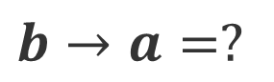
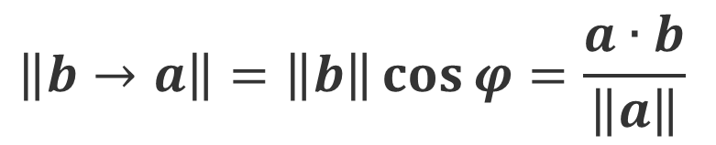
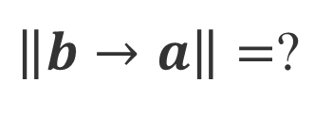
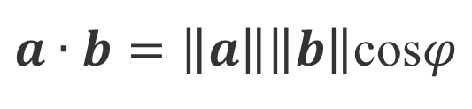
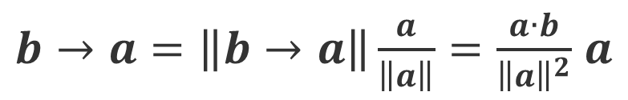
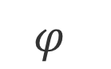
Projections (of b on a)
b
$a∙b=\left\|a\right\|\left\|b\right\|$cos$φ$
$$φ$$
a
$$\left\|b→a\right\|=\left\|b\right\|\cos{φ}=\frac{a∙b}{\left\|a\right\|}$$
$\left\|b→a\right\|=$?
$$b→a=?$$
$b→a=\left\|b→a\right\|\frac{a}{\left\|a\right\|}=\frac{a∙b}{{\left\|a\right\|}^{2}}$ $a$
Notes:
So let's now as a final step, look at the projection of vector b on a. So very often you want to know what fraction of the vector b lies on a.
And this can be done easily with the dot product. Essentially it's equal to the norm of the vector b, times the cosine. So we can say that the projection of the vector b on a is equal to the norm of the vector b times the cosine of the angle between them. Because that's the definition, the component of b along vector a is given by the cosine. And this is simply a dot product of the vector a and the vector b, which is what the cosine is, divided by the norm of a and the norm of b.
Now the norm of b cancels and what you are left with is the dot product of a and b divided by the magnitude of the vector a. And so the question is what is the component of b along a given by? We will have to multiply by the unit vector along the a direction. We already have the length in the first formula but now you need to multiply by this term. So this term here is the unit vector. So it is the unit vector which has a length of 1. And you multiply by that.
Now, b projection on a is a dot b / norm of a, multiplying by the vector a, and dividing by norm of a, makes norm of a squared. And so what you are left with, is the projection of b on the vector a, is this quantity, which involves the dot product between a and b. And the projection is of course, along the direction of the vector a, which is why the final result involves the vector a.

Slide 14
Vector Multiplication
Dot product
Cross product
Orthonormal bases and coordinate frames
Note: Some books talk about right and left-handed coordinate systems. We always use right-handed
Notes:
We are now going to consider how vectors can be multiplied to give a vector with what is known as the cross product.

Slide 15
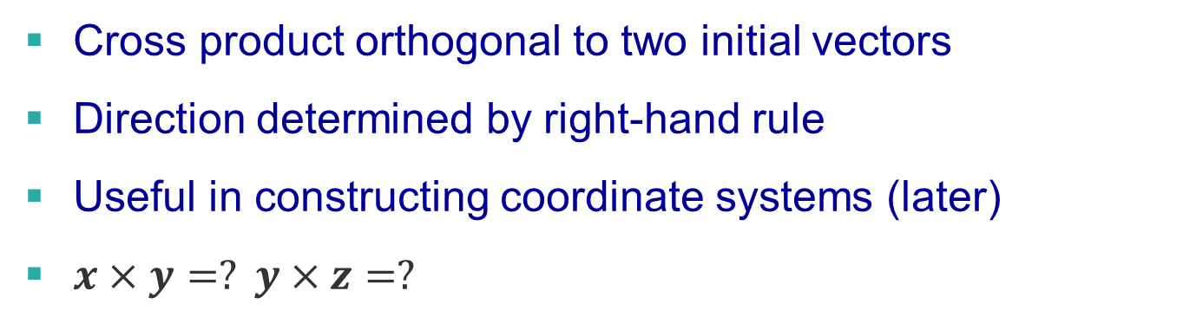
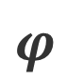
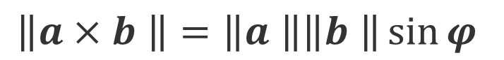
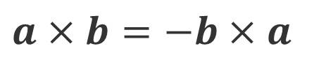
Cross (vector) product
$$a×b=−b×a$$
z
$$\left\|a×b \right\|=\left\|a \right\|\left\|b \right\|\sin{φ}$$
b
b
$$φ$$
y
a
x
a
Cross product orthogonal to two initial vectors
Direction determined by right-hand rule
Useful in constructing coordinate systems (later)
$x×y=? y×z=?$
Notes:
The cross product is denoted not surprisingly with a cross and so it's written as a cross b.
And the idea of the cross product is the area of the parallelogram spanned by a and b. So it is really given by the area of this parallelogram spanned by a and b and then instead of cosine phi, it involves the factor of sine phi. The magnitude is given by the magnitude of a, magnitude of b and instead of the cosine in the dot product it's sine of phi.
But the cross product also has a vector direction, which is given by the right hand rule. And again, the idea is the same. You take your right hand, you curl it from the vector a to the vector b.
And it's where your thumb points. That is where the direction of the cross product is. An interesting point is the way a and b, in which order they come matters unlike for the dot product. So if I were to do b cross a, I would have to take my hand, point it at b, curl it around to the vector a and now my thumb would be pointing down.
So it would be pointing in the opposite direction as a cross b. Therefore we have this negative formula, they are not commutative. a cross b is equal to minus b cross a.
But the very interesting point is that the cross product is orthogonal to both of the initial vectors and therefore it is very useful in creating a coordinate system which we will talk about later.
You can visualize the X, Y and Z axes. And by using the right hand rule, you can yourself verify that these formulae are true. That X cross Y is equal to Z. Y cross Z is equal to X. And Z cross X is equal to Y.

Slide 16
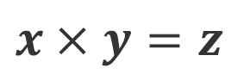
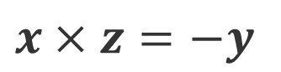
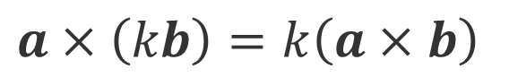
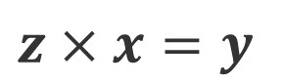
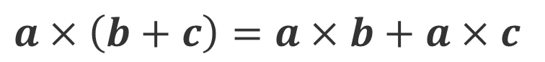
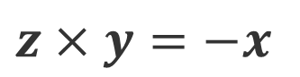
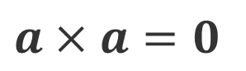
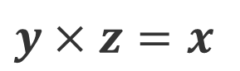
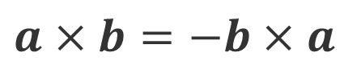
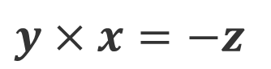
Cross product: Properties
$$x×y=z$$
z
$$a×b=−b×a$$
$$y×x=−z$$
$$a×a=0$$
$$y×z=x$$
$$a×\left(b+c\right)=a×b+a×c$$
$$z×y=−x$$
y
$$a×\left(kb\right)=k\left(a×b\right)$$
$$z×x=y$$
x
$$x×z=−y$$
Notes:
It's easy to memorize this by just thinking about the sequence x, y and z and cyclically if you go around it, x cross y will be z, y cross z will be x, and z cross x will be y. If you flip the order, you negate the sign.
Here are some properties of the cross product which you can consider here. a cross b is equal to minus b cross a.
Cross product of a vector with itself because the sign is 0 is 0, we have associativity, a cross (b + c) is equal to (a cross b) + (a cross C) and scaling a vector by scalar, scales the whole cross product. Those are the basic properties of the cross product.

Slide 17
In class practise:
$$a×b=\left(x_{a}X+y_{a}Y+z_{a}Z\right)×\left(x_{b}X+y_{b}Y+z_{b}Z\right)$$

Slide 18
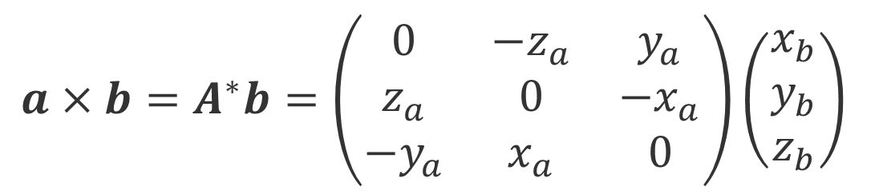
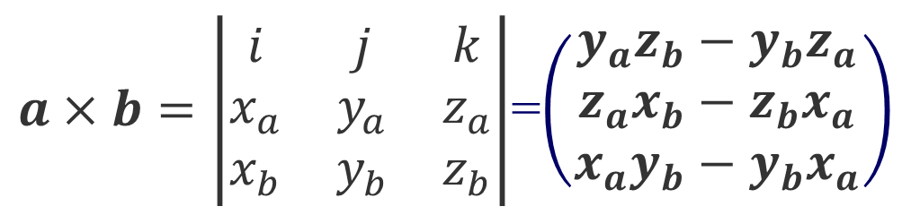
Cross product: Cartesian formula?
$a×b=\left|\begin{matrix}i & j & k \\ x_{a} & y_{a} & z_{a} \\ x_{b} & y_{b} & z_{b}\end{matrix}\right|$=$\left(\begin{matrix}y_{a}z_{b}−y_{b}z_{a} \\ z_{a}x_{b}−z_{b}x_{a} \\ x_{a}y_{b}−y_{b}x_{a}\end{matrix}\right)$
$$a×b=A^{∗}b=\left(\begin{matrix}0 & {−z}_{a} & y_{a} \\ z_{a} & 0 & −x_{a} \\ {−y}_{a} & x_{a} & 0\end{matrix}\right)\left(\begin{matrix}x_{b} \\ y_{b} \\ z_{b}\end{matrix}\right)$$
Dual matrix of vector a
Notes:
The formula for the cross product can be derived. When we derive the formula, what we want to do is consider a vector that's given by x_a times X, plus y_a times Y, plus z_a times Z.
And now we want to take the cross product of this vector, so I'll just write this as a cross product with the same thing. So we had x_b, y_b and z_b, and so we can consider the vectors, X, Y, and Z. Okay, so now if you take the cross product because of associativity you can consider all of the different nine terms in the cross product. Let's consider some possibilities, so if you consider X cross X, but you know that X cross X is equal to zero, we know that X cross product with X is going to be equal to 0, as is Y cross Y and Z cross Z. That's because any vector cross product with itself, the sign is equal to 0. So the terms x_a * x_b, y_a * y_b and z_a * z_b will disappear.
Now we can consider the X cross Y term so X cross Y here and I can write that as x_a times y_b. It involves X cross Y, but we know that X cross Y is equal to Z.
And so I write this as the vector Z. Equivalently here, we have Y cross X, so y_a * x_b. But now we have Y cross X. And we know that Y cross X is equal to -X cross Y. So we can put this as a negative sign, and this is the vector Z. So now we have (x_a * y_b - y_a * x_b) * Z.
So, I can write this down. There are similar kinds of results for X and Y.
Which allows us to create the formula shown here. So a cross b is written in this way in terms of a determinant. So in the determinant the first value X involves (y_a * z_b - z_a * y_b). So (y_a * z_b - y_b * z_a).
The next value Y involves (z_a * x_b - x_a * z_b). And Z involves (x_a * y_b - y_a * x_b). So (x_a * y_b - y_a * x_b). Normally determinants are used to evaluate numbers but in this case it's a simple way of doing it where you note that the X, Y and Z here are vectors.
And similarly here this corresponds to X, this corresponds to Y and the last row corresponds to Z.

Slide 19
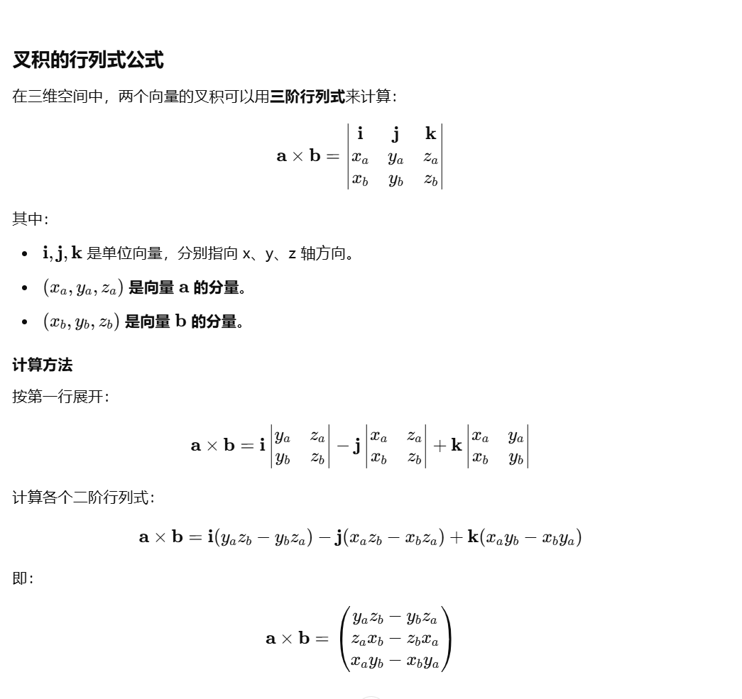
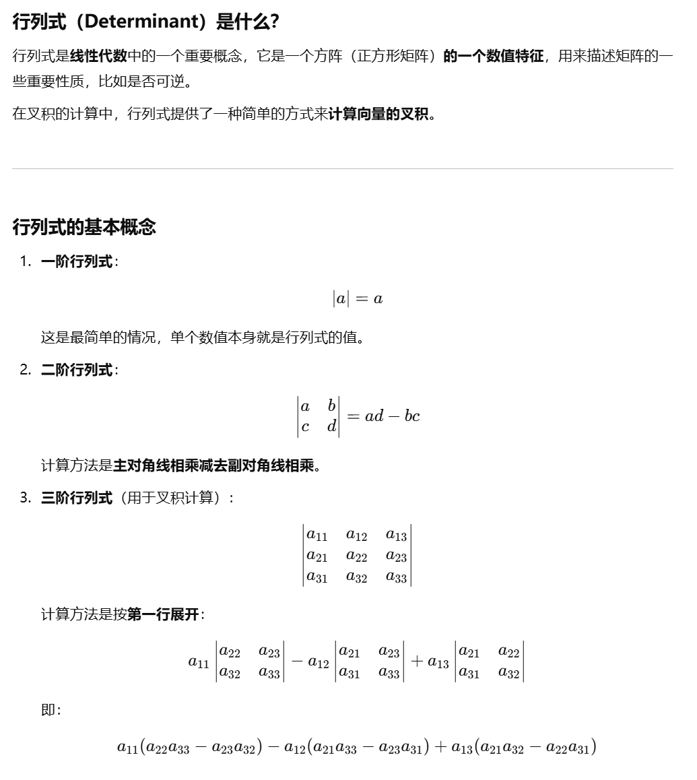
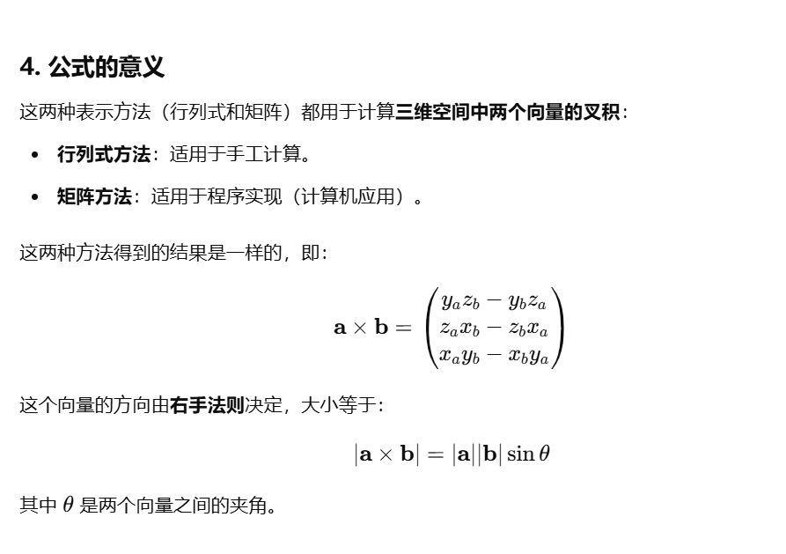
∣a×b∣=∣a∣∣b∣sin是两个向量的大小，它的方向用右手法则，而叉积则相当于已经涵盖整个方向θ

Slide 20
Vector Multiplication
Dot product
Cross product
Orthonormal bases and coordinate frames
Note: book talks about right and left-handed coordinate systems. We always use right-handed
Notes:
we are going to see how to use dot and cross products to create an orthonormal coordinate frame which will be useful in many applications.

Slide 21
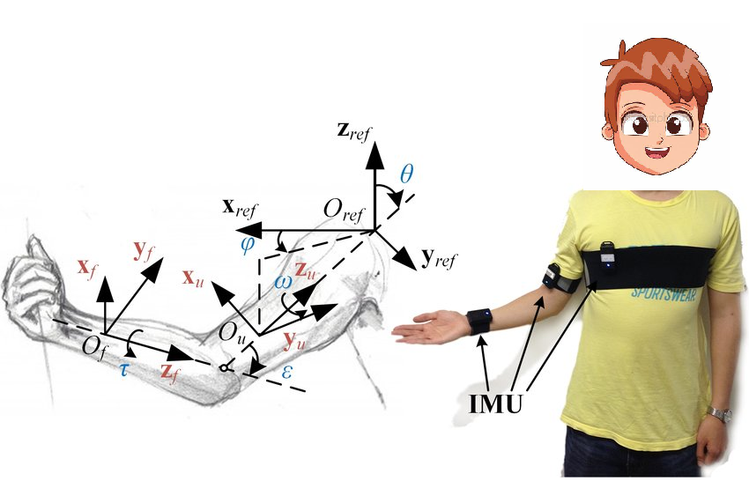
Orthonormal bases/coordinate frames
Important for representing points, positions, locations
Often, many sets of coordinate systems (not just X, Y, Z)
Global, local, world, model, parts of model (head, hands, …)
Critical issue is transforming between these systems/bases
Topic of next 3 lectures
Notes:
Orthonormal bases and coordinate frames are important for representing points, positions, locations.
Often there are many different sets of coordinate systems. So not just your single XYZ coordinate systems. In graphics this is very common that you will have a coordinate system associated with the model, you will have a coordinate system associated with the local coordinates, you will have a coordinate system associated with the world, you may even have separate coordinate systems for the head, for the shoulder, for the hands, for the torso, for the legs, for the shoes, so on.
And a very important part is to get all of these different objects in their consistent frame of reference. So a critical issue is transforming between these different coordinate systems. In fact the next 3 lectures deal with the transformations and viewing and the way in which you can use matrices and vectors for that purpose.

Slide 22
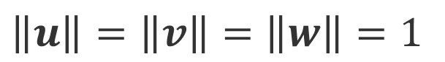
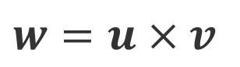
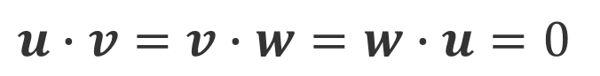
Coordinate Frames
Any set of 3 vectors (in 3D) so that
$$\left\|u\right\|=\left\|v\right\|=\left\|w\right\|=1$$
$$u∙v=v∙w=w∙u=0$$
$$w=u×v$$
$p=\left(p∙u\right)u+$ $\left(p∙v\right)v+\left(p∙w\right)w$
Notes:
So what is a coordinate frame? It's any set of 3 vectors in 3 dimensions, such that the vectors are of unit norm. Such that the vectors are mutually orthogonal to each other. And such that they obey this cross product relationship, which is that w is equal to u cross v. You can think of all of these in terms of X, Y and Z. Of course, the unit X, Y and Z vectors are of unit norm. Of course they're mutually orthogonal with respect to each other. And, of course, the Z vector is simply equal to X cross Y.
One of the interesting things about this is that a vector p can be written in terms of its projections onto the vectors u, v and w. So, p dot u is the projection onto the vector u, with the vector u. p dot v is the projection onto the vector v, times the vector v. p dot w is the projection onto the vector w, times the vector w.

Slide 23
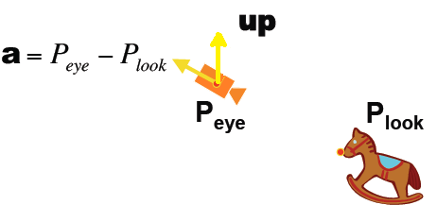
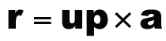
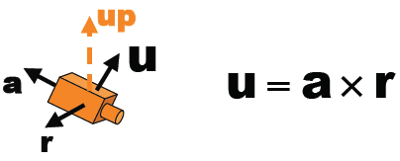


Constructing a coordinate frame
Often, given a vector a (viewing direction) want to construct an orthonormal basis
Need a second vector up (up direction of camera)
Construct an orthonormal basis (for instance, camera coordinate frame to transform world objects into)
Notes:
How do you construct the coordinate frame? So, the first question, why do you want to construct the coordinate frame? It's often the case that you're given a vector a, which in assignment 1, will be the viewing direction. You want to create an orthonormal basis from this. But of course, an orthonormal basis involves 3 unit vectors and you can't get it from a single vector, so need a second vector b, which in assignment 1 is the up direction of the camera.

Slide 24
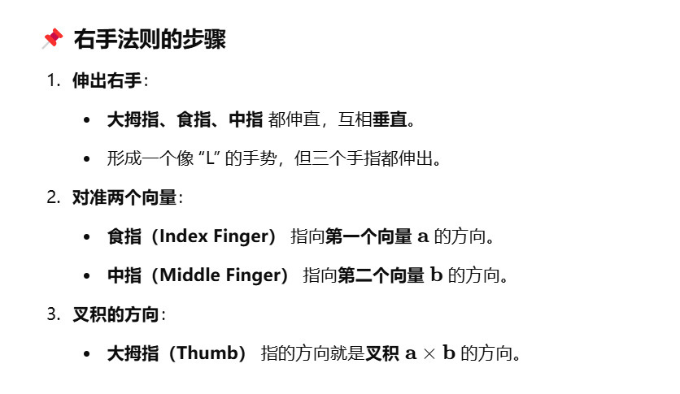
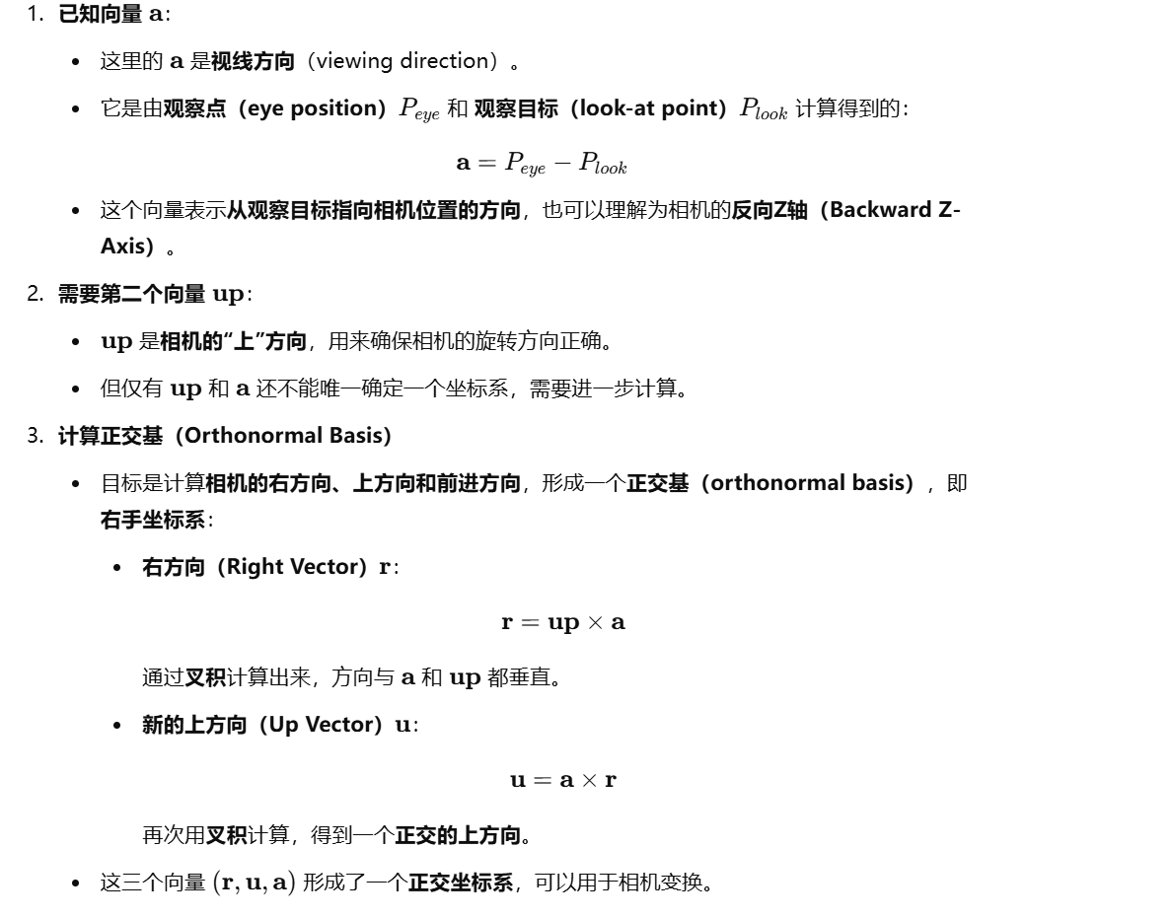
在世界坐标系中，上为（010）右为（100）前为（001）建立自己的坐标系时，你的up如果要根据比如手机斜着放想要up也斜着，就要看此时的up在世界坐标系处于哪个地方，

Slide 25








Constructing a coordinate frame?
The below unit vectors forms a coordinate frame.
$$1. \hat{a}=\frac{a}{\left\|a\right\|}$$
$$\hat{u}$$
$$r$$
$$\hat{a}$$
2. $\hat{r}=\frac{up×a}{\left\|up×a\right\|}$
$$\hat{r}$$
$$α=\frac{a}{\left\|a\right\|}$$
$$b$$
$$3. \hat{u}=\frac{a×r}{\left\|a×r\right\|}$$
$$u$$
Notes:
So given 2 vectors a and b, how to create an orthonormal coordinate frame? Intuitively, you want to associate the vector w with a and the vector v with b. But, a and b are neither orthogonal vectors nor are they a unit norm, and we also need to find the u vector.
First let's try to find what the vector w is equal to. And the vector w should just be given by the vector a in this case. But the only problem with this is that A is not of unit norm, so we need to normalize it.
And we simply divide by the magnitude of the vector a. So that part is simple, the vector w is equal to the a divided by the unit norm of a. But how do we get v and u? That part is complicated, so why is is complicated? If the vector b is orthogonal to the vector a you're completely fine, you can just define b based on that.
The vector b may not be orthogonal to the vector a. So one thing to do is to remove its projection in the direction of a which would be a dot product but there is in fact a more elegant way of doing this. Even though b and now w are not necessarily orthogonal to each other we can use the cross product to find the third vector which is orthogonal to both b and w. So instead of finding the vector v, we first find the vector u. You write the vector u as equal to b cross product with w and divide the whole thing by the norm of b cross w.
And that's the formula I have written here, u is equal to b cross w divided by the norm of b cross w. The final step we need here, is to find the vector v, but given w and u, v is given by, w cross product with u. In this way you have created a complete coordinate frame, given 2 vectors, that need not be unit norm, that need not be orthogonal.
Of-course this fails when the norm, when this quantity is equal to zero, so if b and w are aligned with each other, in which case their cross product is equal to zero, then they are really the same vector, a and b are the same vector and you cannot create the coordinate frame.

Slide 26




Constructing a camera coordinate frame
up can be chosen from （0，1，0）， （0， -1， 0）， （1， 0， 0）， （-1， 0， 0）， （0， 0， -1）， （0， 0， 1）
$$\hat{r}$$
$$\hat{u}=up$$
$$\hat{a}$$
up=（0，1，0）
$$\hat{a}$$
$$\hat{r}$$
$$\hat{u}$$
$$r$$
up=（1, 0, 0）
The camera coordinate frame is attached to the camera.

Slide 27

Matrices
Can be used to transform points (vectors)
Translation, rotation, shear, scale
Array of numbers (m×n = m rows, n columns)
Addition, multiplication by a scalar simple: element by element
$$\left(\begin{matrix}1 & 3 \\ 5 & 2 \\ 0 & 4\end{matrix}\right)$$
Notes:
we will talk about matrices, which are also very important. Most transformations involve a matrix multiplying a vector.
Matrices can be used to transform points. The next few lectures will talk about their use for translation, rotation, shears, scales. In fact, all transformations and the graphics pipeline are handled by matrices.

Slide 28


Matrix-matrix multiplication
Number of columns in first must = rows in second
Element (i,j) in product is dot product of row i of first matrix and column j of second matrix
$$\left(\begin{matrix}1 & 3 \\ 5 & 2 \\ 0 & 4\end{matrix}\right)\left(\begin{matrix}3 & 6 \\ 2 & 7\end{matrix} \begin{matrix}9 & 4 \\ 6 & 8\end{matrix}\right)=\left(\begin{matrix}9 & 27 \\ 19 & 44 \\ 8 & 28\end{matrix} \begin{matrix}27 & 28 \\ 57 & 36 \\ 24 & 32\end{matrix}\right)$$
Notes:
8
So here, I've shown how the matrix multiplication works. The highlight is on the first row of the first matrix and the result. Note that in element (i,j), so this is the element in the top left, and starting to number my rows and columns from 1, I can say that this is element (1,1).
So it will be a dot product of row 1 and so I can number these rows as 1, 2, 3, and I can similarly number the columns as 1, 2, 3, 4. So it will be a dot product of row 1 and column 1 in order to highlight the different columns here I have used the color red.
Ans so 1 times 3 is 3, 3 times 2 is 6, you add these together in the dot product. It's 9, and that's the value. Notice the color of highlighting so, red is used to highlight the first column here, first column here and so you get the dot product of [1, 3] and [3, 2] for this number. Similarly, for this number here its dot product of [1, 3] and [6, 7] so, 1 times 6 is 6, 3 times 7 is 21, you get 27.
Now the next one, 1 times 9 is 9, 3 times 8 is 24, you get 33. 1 times 4 is 3 times 3 is 9, you get 13.
And similarly, we can apply this to the next row. And so we take the dot product with each column to give each element of this matrix. For example, for the first one, 5 times 3 is 15, 2 times 2 is 4, 19. 5 times 6 is 30, 2 times 7 is 14, 44. 5 times 9 is 45, 2 times 8 is 16, 61. 5 times 4 is 20, 2 times 3 is 6, 26.
And the final example here, the first one is 0, so we don't even need to consider it. 4 times 2 is 8, 4 times 7 is 28, 4 times 8 is 32, 4 times 3 is 12. And this is the way matrix multiplication works.

Slide 29

Matrix-matrix multiplication
Number of columns in first must = rows in second
Not even legal!
Non-commutative (AB and BA are different in general)
Associative and distributive
A(B+C) = AB + AC
(A+B)C = AC + BC
$$\left(\begin{matrix}3 & 6 \\ 2 & 7\end{matrix} \begin{matrix}9 & 4 \\ 6 & 8\end{matrix}\right)\left(\begin{matrix}1 & 3 \\ 5 & 2 \\ 0 & 4\end{matrix}\right)$$
Notes:
Matrix multiplication is not commutative. If I reverse the order of the matrices here, it's not even a legal operation. The number of columns in the first matrix, in this case, is 4. The number of rows in the second, in this case, is 3, and it's not commutative. Even if the matrices actually have dimensions that they can be multiplied, it's still not commutative. However, matrix multiplication is associative and distributive. So a * (b+c) is equal to ab + ac. (a + b) * c is equal to ac + bc.

Slide 30

Matrix-Vector Multiplication
Key for transforming points (next lecture)
Treat vector as a column matrix (m×1)
E.g. 2D reflection about y-axis
y
$\left(\begin{matrix}−1 & 0 \\ 0 & 1\end{matrix} \right)\left(\begin{matrix}x \\ y\end{matrix}\right)$= $\left(\begin{matrix}−x \\ y\end{matrix}\right)$
x
Notes:
Matrix-vector multiplication is key for transforming the points and this is the main topic we will be treating in the next few lectures. We can treat the vector as a column matrix, m rows times 1 column. And just as a simple example, I've shown you 2D reflection about the Y axis, so let's talk about reflection for a minute.
So I have my screen, this is the X axis, this is the Y axis, and I have a point here, which has some coordinates (x,y). I wish to reflect it about the Y axis to get a point here. And this will have coordinates, (-x,y).
That's what reflection about the y axis is. If you think about this matrix equation, the new x coordinate is -1 times x plus 0 times y, which is -x, and 0 times x plus 1 times y, which is y. So reflection is given by this equation, [-1 0, 0 1], whereas the identity would just have this as plus 1. So this is a simple example of how matrix vector multiplication can be used to transform points corresponding to a particular operation.

Slide 31

Transpose of a Matrix (or vector?)
${\left(\begin{matrix}1 & 5 & 0 \\ 3 & 2 & 4\end{matrix}\right)}^{T}$=$\left(\begin{matrix}1 & 3 \\ 5 & 2 \\ 0 & 4\end{matrix}\right)$
(AB)^{T}=B^{T}A^{T}
Notes:
The other interesting thing we consider is the transpose of a matrix. And that simply replaces the rows with columns, so you can think of [1 2] being the first row becomes the first column, [3 4] second column, [5 6] third column. We can also transpose a vector in which the column vector becomes a row vector and vice versa.
One interesting property on the matrix transpose, it also applies to matrix inverses, is that, if you want to transpose the product of 2 matrices, A and B, A times B transpose, you just transpose the individual matrices, so you transpose B and you transpose A, but you have to flip the order. So you have to reverse the order in which the transposes are applied. So it will be B transpose times A transpose. That's a very useful property to know.

Slide 32

Identity Matrix and Inverses
$$I_{3×3}=\left(\begin{matrix}1 & 0 & 0 \\ 0 & 1 & 0 \\ 0 & 0 & 1\end{matrix}\right)$$
(AB)⁻¹=B⁻¹A⁻¹
AA⁻¹=A⁻¹A=I
Notes:
The identity matrix is useful to define, and so the dimensions of the matrix have noted here 3 by 3. It just has ones along its main diagonal, zeroes elsewhere. And the properties of the identity matrix is the matrix times its inverse is equal to inverse times matrix, is the identity. How do you, do the inverse of A times B, it's A inverse B inverse, but you have to change the order. So if I consider, B inverse times A inverse, times A, times B.
You can see that this becomes the identity, and then B inverse times B, also becomes the identity. So changing the order is in fact, the right thing to do. If I don't change the order, the result is not the identity.

Slide 33


Vector multiplication in Matrix form
Dot product?
Cross product?
$a∙b=a^{T}b=\left(\begin{matrix}x_{a} \\ y_{a} \\ z_{a}\end{matrix}\right)∙\left(\begin{matrix}x_{b} \\ y_{b} \\ z_{c}\end{matrix}\right)$ =$x_{a}x_{b}$+$y_{a}y_{b}\text{+}z_{a}z_{b}$
$$a×b=A^{∗}b=\left(\begin{matrix}0 & {−z}_{a} & y_{a} \\ z_{a} & 0 & −x_{a} \\ {−y}_{a} & x_{a} & 0\end{matrix}\right)\left(\begin{matrix}x_{b} \\ y_{b} \\ z_{b}\end{matrix}\right)$$
Dual matrix of vector a
Notes:
Finally let's relate matrices back to the dot product and the cross product. And we want these vector multiplication operations, a dot b and a cross b to be represented in terms of matrix-vector multiplication.
So a dot b just multiplies the same components of vector a with vector b, and there is a very easy way to represent this in matrices, as a transpose b (a^T * b). So, if the vector is a column vector, the transpose is x_a, y_a, z_a. The number of columns 3 is equal to the number of rows, and the dimensions of the matrix is the number of rows, here 1 and the number of columns, here 1. And so you have x_a * x_b + y_a * y_b + z_a * z_b.
Next, we come to the cross product. We've already seen it when we discussed cross products. You can do it using the dual matrix of the vector a, and so you can represent it as "A star" (A*) times b, where A* is the dual matrix of the vector a.

Slide 34


Writing assign 1
$a∙b=\left\|a\right\|\left\|b\right\|$cos$φ$
1. Prove:
2. Check:
$a×b=\left|\begin{matrix}x & y & z \\ x_{a} & y_{a} & z_{a} \\ x_{b} & y_{b} & z_{b}\end{matrix}\right|$=$\left(\begin{matrix}y_{a}z_{b}−y_{b}z_{a} \\ z_{a}x_{b}−z_{b}x_{a} \\ x_{a}y_{b}−y_{b}z_{a}\end{matrix}\right)$

Slide 35




f
3. Please draw a, up, r, u vector on the below pictures, and specify which up you choose.
c)
d)
a)
b)

